Slide 1
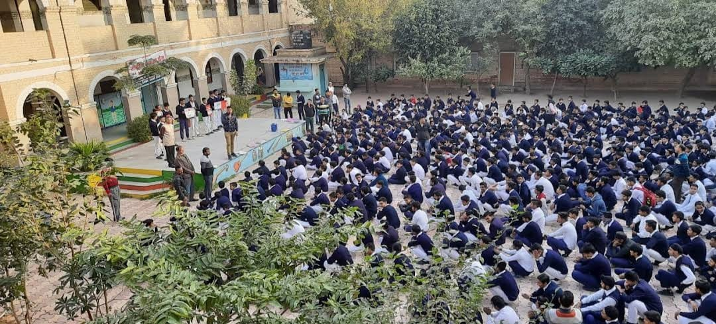
R.S.B.V GANDHI NAGAR SCHOOL START- UP STORMERS UNDER NEEEV
By The ALLIED

Slide 2

Rehan (CEO)
ID 20200027145
9990385133
Farzan (CFO)
ID 20200028612
9773823019
Sahin Mallick (MH)
ID 20250321192
9213850689
Jhujhar Singh ji (COO)
ID 20230220992
9821713173
Nitin (HR)
ID 20190037560
7838804917
MEET THE WORKFORCE

Slide 3

BUSINESS IDEA Our business focuses on creating a Tap-Mounted Water Softener Device designed to instantly convert hard water into soft water for bathing, washing face, and daily use. This device attaches directly to any household tap and uses natural filter media to reduce hardness-causing minerals like calcium and magnesium. The aim is to provide an affordable and easy solution for people facing hair fall, dry skin, and soap-formation problems caused by hard water.

Slide 4
OUR PROJECT IDEA
Aqua Soft

Slide 5
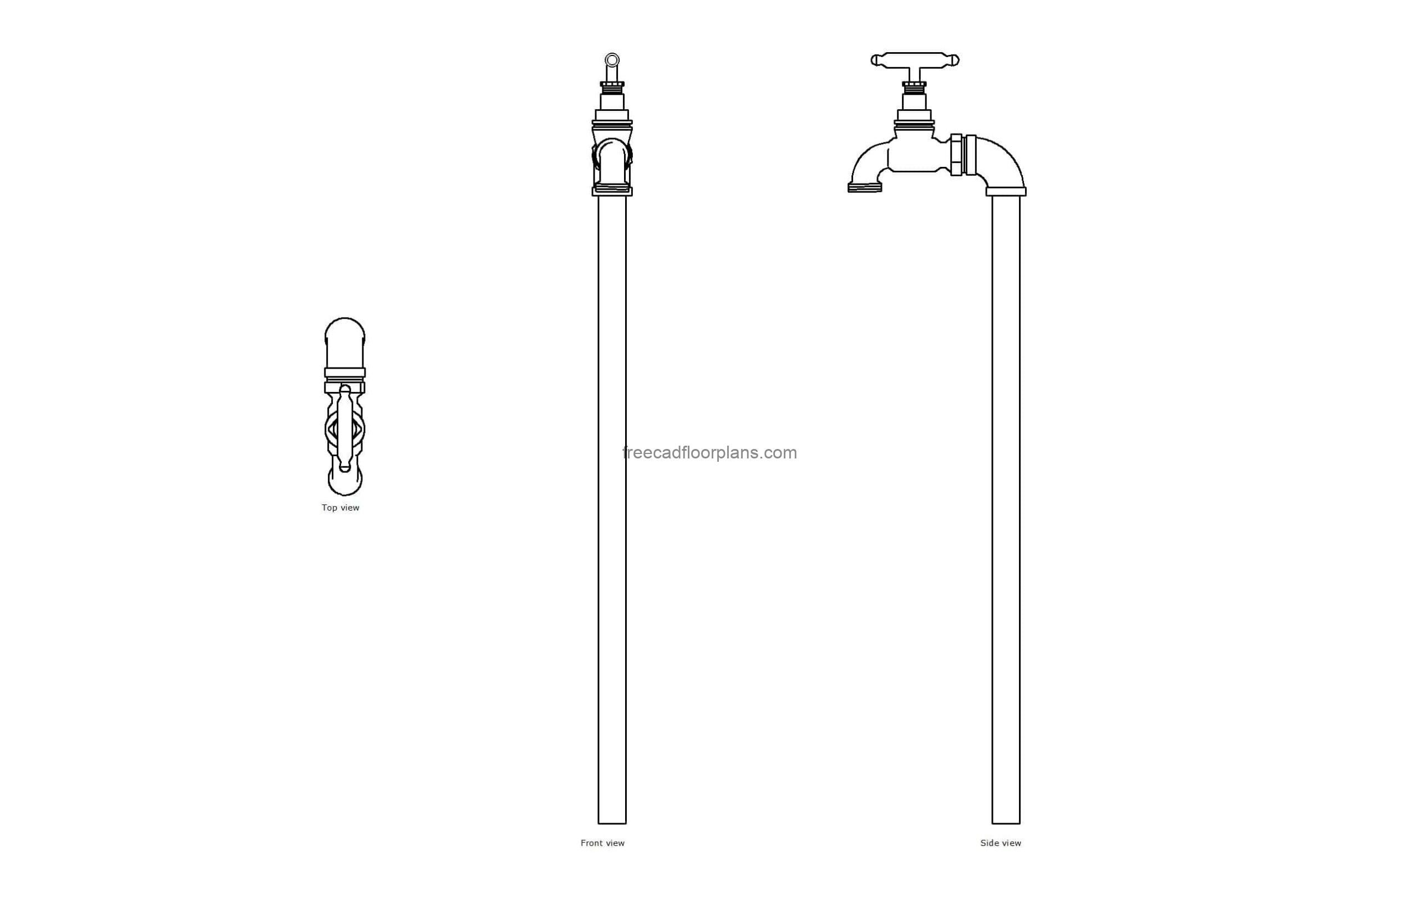
PROJECT NAME- Aqua Soft
Rubber Nozzle
Activated carbon
Ion-Exchange
Filter/Sediment mesh
Aerator

Slide 6
DESCRIPTION Aqua Soft will manufacture a compact easy-to-install tap-mounted softener using multi-layer filtration. The filter contains activated carbon, ion-exchange resin, and sediment mesh that removes hardness, chlorine, and impurities. It improves water quality without electricity and fits all standard taps. Our target audience includes households, hostels, PGs, salons, and rented apartments where hard water is a daily issue.

Slide 7
MARKET OVERVIEW Hard water is a major problem in many Indian cities and rural areas. With increasing awareness about skin and hair health, the demand for affordable home softening solutions is rising. Our product is ideal for renters and families who cannot install large RO softening systems. This industry has strong growth potential as more people seek quick, portable, and low-cost solutions.

Slide 8
BUSINESS MODEL Abstract: Created to solve the increasing problem of hard water in Indian homes. Design: Small tap-mounted device with refillable filter cartridge
Research: Built after studying common hard-water effects like dry skin, dull hair & soap scum. Market Overview: High demand in urban/rural areas due to high TDS levels.

Slide 9
MARKETING PLAN
We will promote AquaSoft through social media platforms like Instagram, YouTube, and WhatsApp, where we will share simple videos and photos showing how the device works.
We will also create posters and small advertisements
to display in school and nearby areas to spread
awareness about our product.

Slide 10
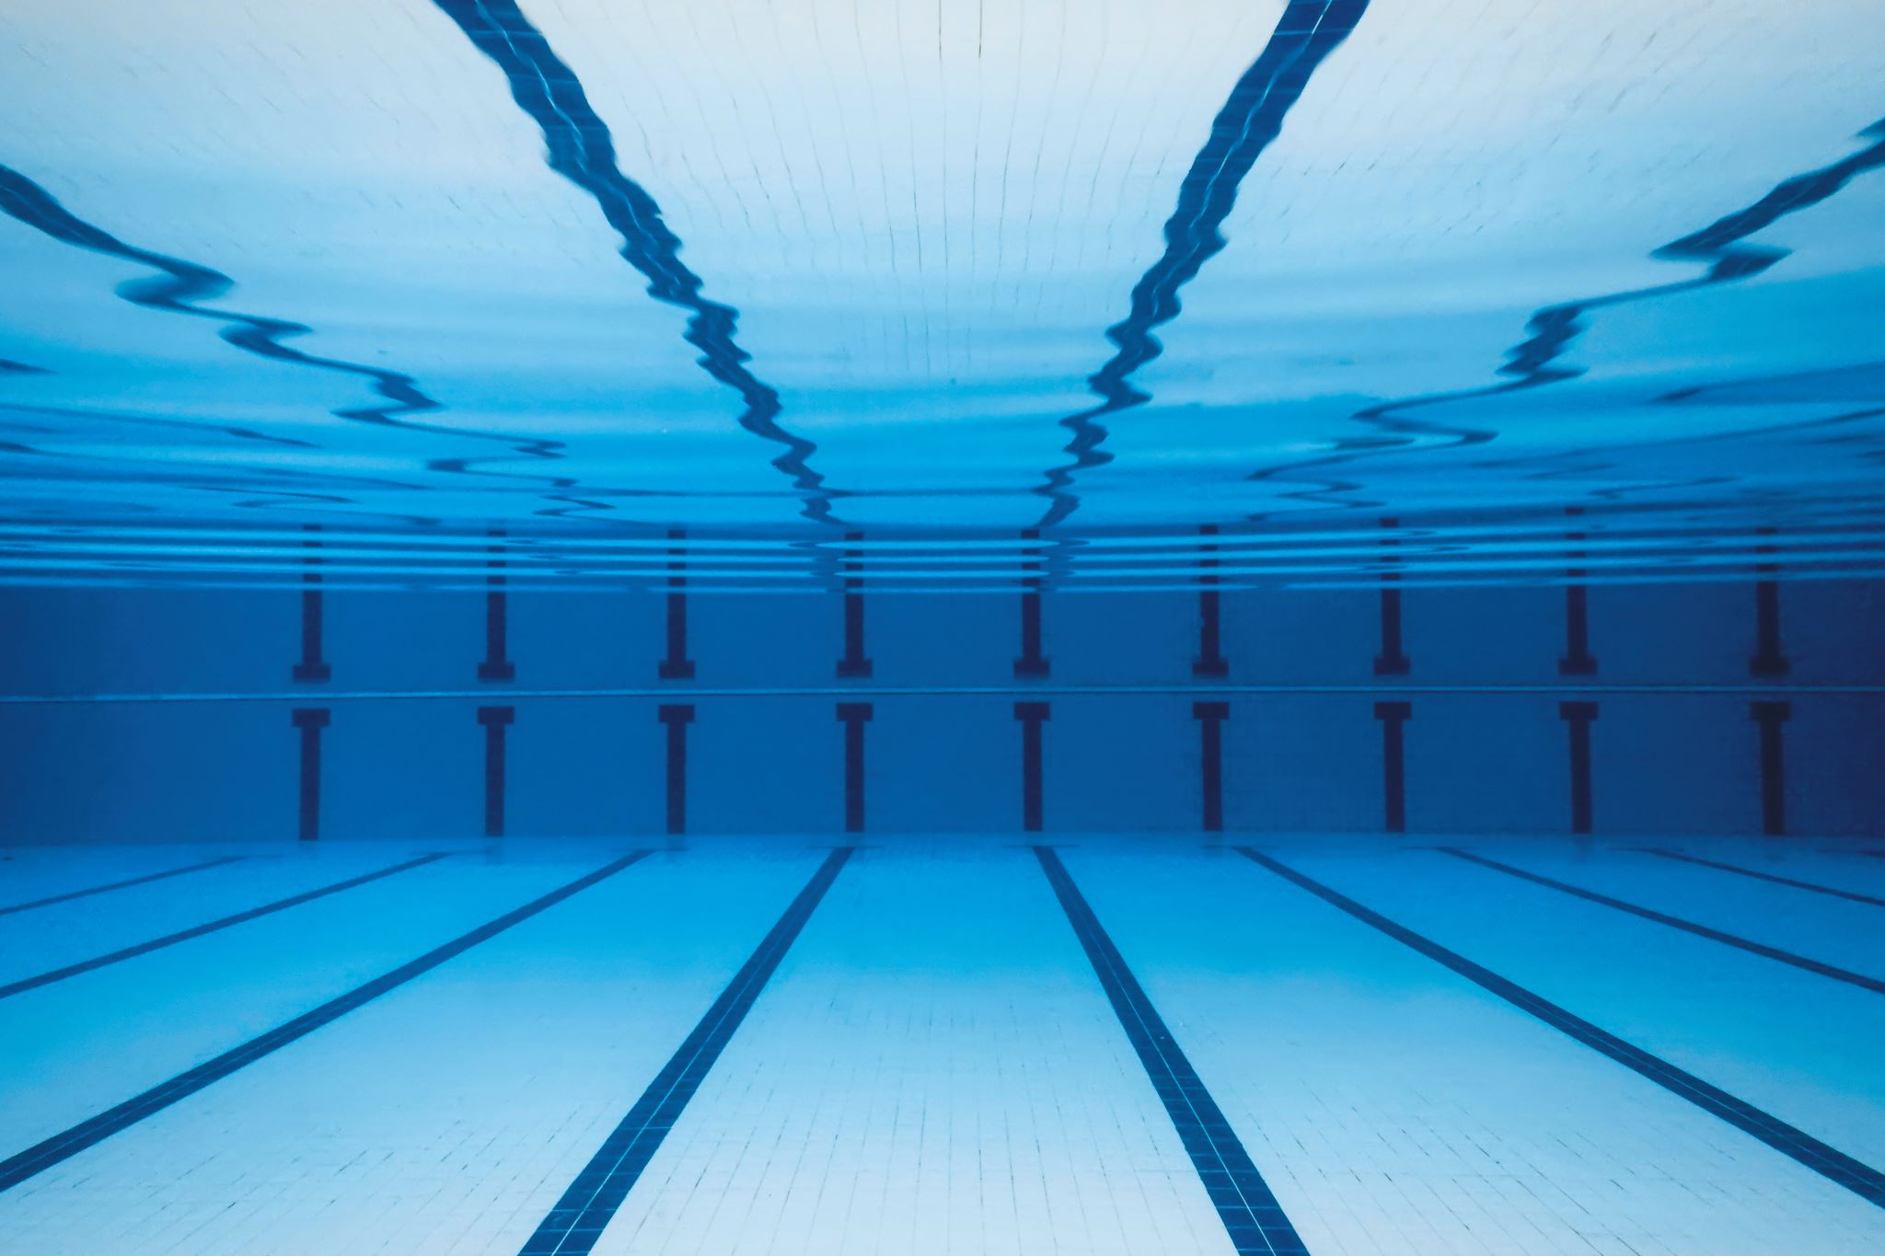
COMPONENTS & COST
________________________________________________
Component Source lon Exchange Resin Rs 25 Activated Carbon Rs 40 Sediment Filter Mesh Rs 05 Plastic Outer Casing Rs 15 Rubber Seals / Adapters Rs 45 Aerator RS 10
Miscellaneous (glue, washers) Rs 10 Total Cost per Unit 150 Selling Price 249 Profit Margin 99 ______________________________________________________________

Slide 11
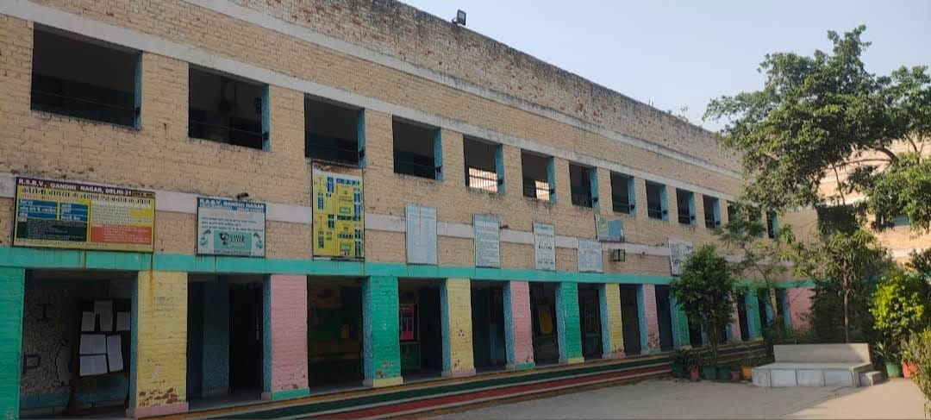
THANKING YOU FOR YOUR PRECIOUS ATTENTION
BY TEAM
ALLIED

